Slide 1

2026 AIO HIGH ACHIEVERS CAMP· SESSION 1
PREFIX SUM
Notes:
这一系列共 4 次课，每次约 2 小时。贯穿全部课程的主线是 AMT 的四大核心技巧：Prefix Sum、Binary Search、Two Pointers 和 Greedy。
第 1 次课讲 Prefix Sum：先讲普通的 prefix sum，再讲"一轮的净变化"（net change per round），最后讲二阶差分（second-order differences）。

Slide 2
THE THREAD THROUGH ALL 4 SESSIONS
AMT'S FOUR CORE TECHNIQUES
Prefix Sum
Binary Search
Signal: range sums, running totals, "net change per round"
Tool: P[i] = P[i-1] + a[i]; sum of a[l..r] = P[r] − P[l-1]
Signal: a bigger answer is harder (or easier) to reach → monotone
Tool: write check(x), use the while (l <= r) template
Two Pointers
Greedy
Signal: two indices that only ever move forward
Tool: outer loop moves one, inner while pushes the other: O(N) total
Signal: each step has an "obviously best" choice
Tool: guess the rule, then prove it with an exchange argument
Notes:
四种颜色在 4 次课里保持不变：青色 = Prefix Sum，橙色 = Binary Search，珊瑚红 = Two Pointers，深蓝 = Greedy。每道题开始时都先标出它用到哪几个技巧。

Slide 3
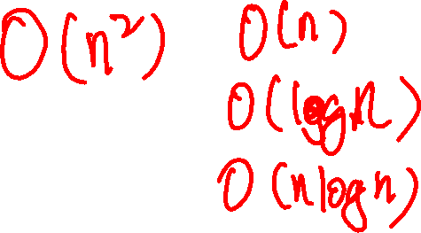
ASK THESE BEFORE EVERY PROBLEM
THREE QUESTIONS
1. What is the brute force? How slow is it, and why?
Brute force = the first subtasks, and your checker for testing later
2. Is anything monotone?
Yes → Binary Search or Two Pointers
3. Can anything be accumulated, split up or decided locally?
Yes → Prefix Sum or Greedy
Notes:
强调：P6 很少是"直接套模板"。四大技巧只是骨架，真正的难点是找到 key observation，把题目化简到能套模板为止。右侧空白用来写学生的回答。
参考答案（以今天的题为例）：
1. Brute force：Spaceship 枚举每条边的流量；Tennis 直接模拟（可达 2×10^11 步）；Twin Rivers 枚举新桥位置 p 再重算所有行程，O(L·T)。
2. 单调的量：Tennis 中每个箱子的球数随轮数线性变化；Twin Rivers 中桥的位置已排序，可以 Binary Search 找最近的桥。
3. 可累加 / 局部决定的量：Spaceship 的边流量是 prefix sum；Tennis 的一轮净变化是 prefix sum；Twin Rivers 的总代价可用二阶差分累加。

Slide 4
THE ROUTE
ONE TECHNIQUE PER SESSION
Session | Theme | Problems
1 | Prefix Sum | Spaceship Shuffle (2022 P6) · Tennis Robot II (2024 P5) · Twin Rivers (2024 P6)
2 | Binary Search + Two Pointers | Laser Cutter (2021 P6) · Space Mission (2021 P5) · Lollipops II (2019 P6)
3 | Greedy ("water level") + binary search on the answer | Mundane Square (2026 P6) · Wheeling and Dealing (2023 P5) · Prime Minister (2026 P5)
4 | Sparse Table + Greedy | Ladybugs II (2020 P5) · Robot Writing (2025 P6) · Beach Umbrellas (2020 P6)
Yet Another Lights (2023 P6) is a parity construction that uses none of the four techniques: optional reading.
Notes:
每道 Problem 5 都和同一次课的一道 Problem 6 配对：核心想法相同，化简步骤更短，用来巩固。

Slide 5

2022 AIO PROBLEM 6
SPACESHIP SHUFFLE
Cabins in a ring: move the crew into place as cheaply as possible.
Prefix Sum · main
Greedy · support (median)
Binary Search
Two Pointers
Notes:
约 30 分钟。讲解路线：把环剪成链（纯 prefix sum）→ 回到环（多一个变量 f）→ 中位数（median）。

Slide 6
SPACESHIP SHUFFLE
THE PROBLEM
N cabins form a ring. Cabin i has A[i] crew now and needs B[i].
Moving one person to an adjacent cabin costs $1. Find the minimum total cost.
N ≤ 100 000, A[i], B[i] ≤ 100 000, ΣA = ΣB
Restate it: the ring has N edges. Let flow be the net number of people crossing an edge (it can be negative).
Total cost = Σ |flow|
Notes:
提问：为什么只看净流量（net flow）？
答案：如果同一条边上有人往左、有人往右，让他们互换身份，花费只会减少。所以最优解里每条边只有一个方向。
右侧空白可以画一个 6 个 cabin 的环。

Slide 7
SPACESHIP SHUFFLE · START SIMPLE
CUT THE RING INTO A CHAIN
Subtask 2: nobody crosses the edge N → 1. Every extra person left of edge i → i+1 must cross it:
flow[i] = (A[1]−B[1]) + … + (A[i]−B[i]) = P[i]
That is a Prefix Sum. Answer = Σ |P[i]|, in O(N).
Notes:
在黑板上画链 5 2 1 6 5 1 → 3 3 2 7 3 2，从左往右逐条边算 P[i]，让学生看到"左边多出来的人必须穿过这条边"。
参考：A − B = 2 −1 −1 −1 2 −1，P = 2 1 0 −1 1 0，链上答案 Σ|P[i]| = 2+1+0+1+1+0 = 5。

Slide 8
SPACESHIP SHUFFLE · KEY OBSERVATION
BACK TO THE RING: ONE EXTRA VARIABLE
Say f people cross the edge N → 1. Cabin 1 effectively gains f people, so every edge shifts by f:
flow[i] = P[i] + f cost = Σ |P[i] + f|
Now: the points P[i] lie on a number line. Pick one point −f that minimises the total distance to all of them.
Notes:
提问：为什么 flow[N] = f 也符合公式 P[N] + f？
答案：因为 ΣA = ΣB，所以 P[N] = 0。

Slide 9
SPACESHIP SHUFFLE · WHY THE MEDIAN
STAND AT X, STEP ONE TO THE RIGHT
Every point on your left gets 1 further away; every point on your right gets 1 closer.
More points on the right → keep going. Equal on both sides → stop.
You stop at the median.
This is a Greedy: keep stepping in the better direction until no step helps.
Notes:
在下方空白画数轴，标出 P = −1 0 0 1 1 2。让学生站在不同位置，算到所有点的距离之和。
参考答案：站在 −1：0+1+1+2+2+3 = 9；站在 0：1+0+0+1+1+2 = 5；站在 1：2+1+1+0+0+1 = 5；站在 2：3+2+2+1+1+0 = 9。
最小值 5 出现在 0 和 1 之间（两个中位数之间都可以）。这就是 Greedy：一直往更好的方向走，直到走不动为止。

Slide 10
SPACESHIP SHUFFLE · WORK IT BY HAND
SAMPLE 1
A = 5 2 1 6 5 1 B = 3 3 2 7 3 2
i | 1 | 2 | 3 | 4 | 5 | 6
A − B
P[i]
P sorted: ____________ Median: _____ Answer Σ |P − med| = _____
Notes:
答案：A − B = 2 −1 −1 −1 2 −1；P = 2 1 0 −1 1 0；排序后 −1 0 0 1 1 2；median 取 1（取 0 也可以）；答案 Σ|P − med| = 5。
再看样例 2：A = 5 0 0 0 0，B = 1 1 1 1 1，P = 4 3 2 1 0，median = 2，答案 6。如果只能单方向走（f = 0），答案是 10：这就是"环"带来的好处。

Slide 11
SPACESHIP SHUFFLE · CORE CODE
PREFIX SUMS, THEN SORT FOR THE MEDIAN
// prefix sum: p[i] is the flow on edge i -> i+1
for (int i = 1; i <= n; i ++){
p[i] = p[i-1] + a[i] - b[i];
q[i] = p[i];
}
sort(q + 1, q + n + 1);
long long med = q[(n + 1) / 2];
long long ans = 0;
for (int i = 1; i <= n; i ++){
if (p[i] > med) ans += p[i] - med;
else ans += med - p[i];
}
Notes:
强调 long long：P 最大可到 10^5 × 10^5 = 10^10。复杂度 O(N log N)，瓶颈是 sort。

Slide 12
SPACESHIP SHUFFLE · SCORING ROUTE
SUBTASKS AND COMMON MISTAKES
Subtask ladder
Common mistakes
Everyone starts in cabin 1: choose how many go left vs right
No flow across N → 1: plain prefix sums
N ≤ 1000: try f = −P[i] for each i, O(N²)
Full: the median
Using int: P and the answer overflow
Assuming one direction only, forgetting f
Trying every value of f (range up to 10^10)
Notes:
挑战题：如果第 i 条边每人收 w[i] 元，中位数还成立吗？
答案：不能用普通中位数，要用带权中位数（weighted median）：把每个 P[i] 看成权重为 w[i] 的点，取使左右权重平衡的点。

Slide 13
2024 AIO PROBLEM 5
TENNIS ROBOT II
After Spaceship: squeeze a repeating loop into "net change per round".
Prefix Sum · main
Binary Search
Two Pointers
Greedy
Notes:
约 25 分钟。Spaceship 的循环在空间上（cabin 围成一圈），这题的循环在时间上（指令一轮一轮重复）。同一个技巧：把一整轮压缩成一个摘要。

Slide 14
TENNIS ROBOT II
THE PROBLEM
N bins; bin i starts with X[i] balls. M instructions repeat forever: instruction j moves one ball from bin A[j] to bin B[j].
If the robot must take from an empty bin, it stops. How many instructions succeed? Or print FOREVER.
N, M ≤ 200 000, X[i] ≤ 1 000 000
Brute force: simulate. Up to ~10⁶ rounds × 2×10⁵ instructions = 2×10¹¹ steps. Far too slow.
Notes:
问"三问"中的第 1 问：brute force 是什么？为什么慢？
答案：直接模拟；最多约 10^6 轮 × 2×10^5 条指令 = 2×10^11 步。慢在"轮数太多"，接下来就要把轮数压缩掉。

Slide 15
TENNIS ROBOT II · KEY OBSERVATION
SUMMARISE ONE ROUND
1. Walk through the M instructions once. For each bin record d[i] = net change per round, and mn[i] = the lowest change seen just before a take (a prefix-sum minimum).
2. Round r starts with X[i] + (r−1)·d[i] balls. Let s = X[i] + mn[i]. Bin i survives round r ⇔
s + (r−1)·d[i] ≥ 1
3. Solve it with one division: if d[i] < 0, bin i survives t = (s − 1) / (−d[i]) + 1 rounds. R = the smallest t.
4. Then simulate round R+1 only. Answer = R·M + successes in that round.
Notes:
特殊情况：s < 1 表示箱子在第 1 轮就出问题（t = 0）；d[i] ≥ 0 表示箱子永远不会出问题（跳过）；如果没有任何箱子会出问题，输出 FOREVER。
为什么不用 Binary Search？每个箱子的条件都是关于 r 的一次不等式，可以直接解出来。对 R 二分也可以（条件是单调的），但除法更短，边界情况更少。

Slide 16
COMPARE THE PAIR
SAME IDEA: COMPRESS THE LOOP
 | Tennis Robot II (P5) | Spaceship Shuffle (P6)
The loop | In time: instructions repeat | In space: cabins form a ring
Prefix Sum gives | Lowest point mn[i] and net change d[i] per round | Flow P[i] on every edge
Then | Divide to get the rounds, simulate one | Take the median, done
Whenever something repeats, ask: what changes over one full loop?
Notes:
先让学生口头比较两题，再显示表格。
参考答案就是表格内容：循环分别在时间上 / 空间上；Prefix Sum 分别求最低点 mn[i] 和净变化 d[i] / 每条边的流量 P[i]；之后分别用除法算轮数再模拟一轮 / 取中位数。

Slide 17
TENNIS ROBOT II · WORK IT BY HAND
SAMPLE 3
X = 3 2 6 4 5 Instructions: 1→5, 4→3, 2→3, 4→2
Bin | Change before each take | mn | d | s = X + mn | Rounds t
1
2
3
4
5
R = min t = ___ Round R+1 stops at instruction ___ Answer = ___
Notes:
答案：
箱子 1：指令 1 前变化 0 → mn = 0，d = −1，s = 3 → t = (3 − 1) / 1 + 1 = 3。
箱子 2：指令 3 前变化 0 → mn = 0，d = 0，s = 2 → 永远不会出问题。
箱子 3：没被取过，d = +2。
箱子 4：指令 2 前变化 0，指令 4 前变化 −1 → mn = −1，d = −2，s = 3 → t = (3 − 1) / 2 + 1 = 2。
箱子 5：没被取过，d = +1。
所以 R = min(3, 2) = 2。第 3 轮开始时箱子 1 有 1 个、箱子 4 有 0 个。指令 1（1→5）成功；指令 2 要从箱子 4 取球，空了，停下。答案 = 2 × 4 + 1 = 9。
手动验证箱子 4：第 2 轮最低点 3 − 2 = 1（可以），第 3 轮最低点 3 − 4 = −1（失败）。

Slide 18
TENNIS ROBOT II · CORE CODE
ROUNDS BY DIVISION
long long R = -1; // -1: no bin ever fails
for (int i = 1; i <= n; i ++)
if (take[i]){
long long s = x[i] + mn[i];
long long t;
if (s < 1)
t = 0;
else if (d[i] >= 0)
continue;
else
t = (s - 1) / (-d[i]) + 1;
if (R == -1 || t < R)
R = t;
}
if (R == -1) // print FOREVER
Notes:
答案最大可到 10^6 × 2×10^5 = 2×10^11，必须用 long long。整数除法向下取整，正好是公式需要的 floor。
之后：b[i] = x[i] + R·d[i]，从这里模拟一轮，答案 = R·M + 这一轮成功的条数。完整程序见 2024_P5_Tennis_Robot_II.cpp。

Slide 19
2024 AIO PROBLEM 6
ATLANTIS III:
TWIN RIVERS
Prefix Sum, levelled up: second-order differences.
Prefix Sum · main
Binary Search · support
Two Pointers
Greedy
Notes:
约 30 分钟。目标：学生要记住"差分数组 + 一次 prefix sum"能还原分段常数函数（step function），"二阶差分 + 两次 prefix sum"能还原分段线性函数（piecewise-linear function）。

Slide 20
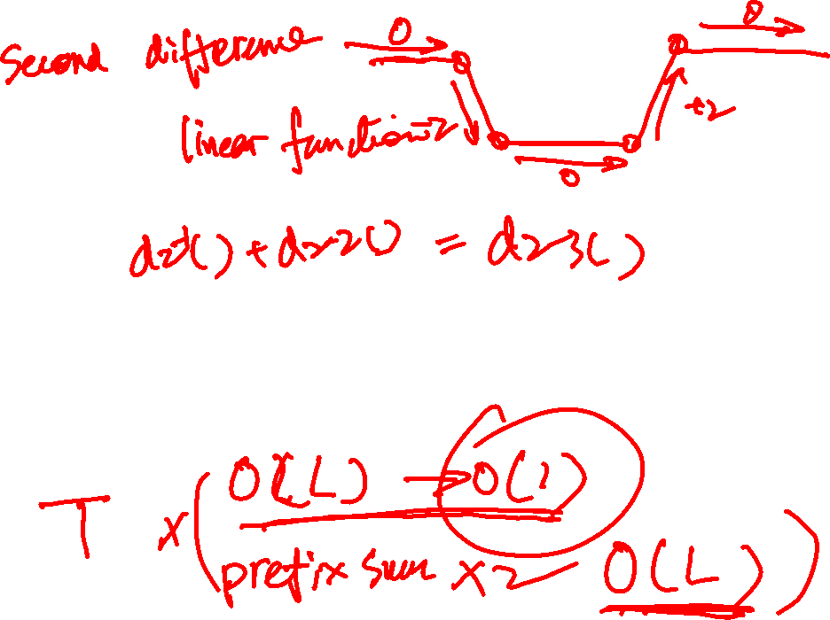
TWIN RIVERS
THE PROBLEM
Three strips of land, two rivers between them; every bridge is 1 km long.
N bridges exist. T trips each go from Strip 1 at position X to Strip S (2 or 3) at the same X.
Build one new bridge (either river, integer position p) to minimise the total length of all trips.
L ≤ 10⁶, N, T ≤ 2×10⁵
Notes:
在右侧画出三条陆地和两条河，用样例 1：River 1 的桥在 2 和 6，River 2 的桥在 4。

Slide 21
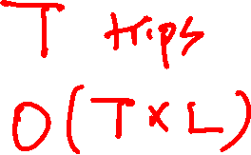
TWIN RIVERS · ONE TRIP FIRST
HOW LONG IS ONE TRIP?
To Strip 2 via bridge b:
1 + 2·|X − b|
To Strip 3 via b₁ then b₂ (walk out and back covers the span twice):
2 + 2·(max(X, b₁, b₂) − min(X, b₁, b₂))
Only the nearest bridge left and right of X can be best → Binary Search on the sorted bridges.
Notes:
Brute force：枚举每个 p，再重算所有行程，O(L·T) ≈ 10^11，只能过 subtask 1。
参考：去 Strip 3 的行程 X = 4，经桥 2 和 4：2 + 2·(4 − 2) = 6；经桥 6 和 4 也是 6。

Slide 22
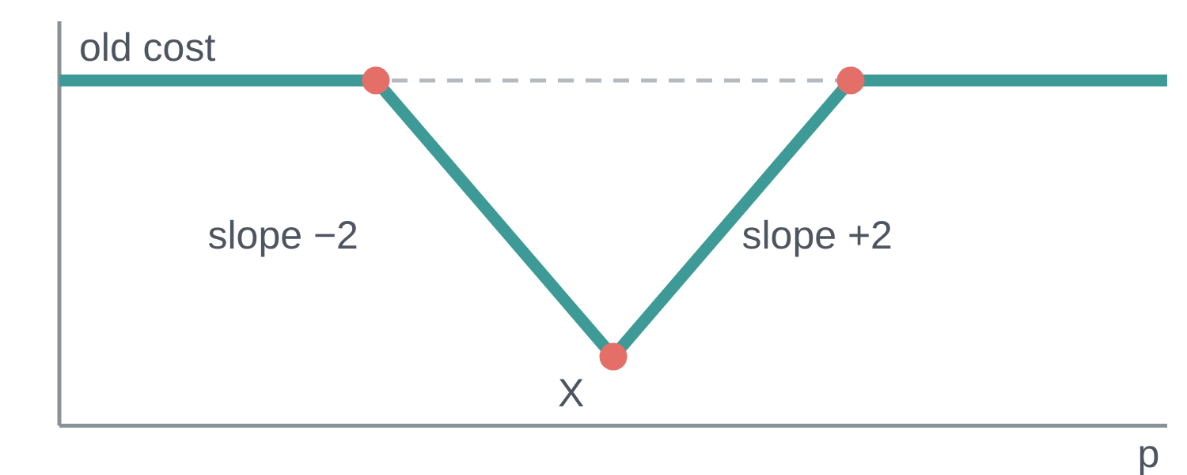
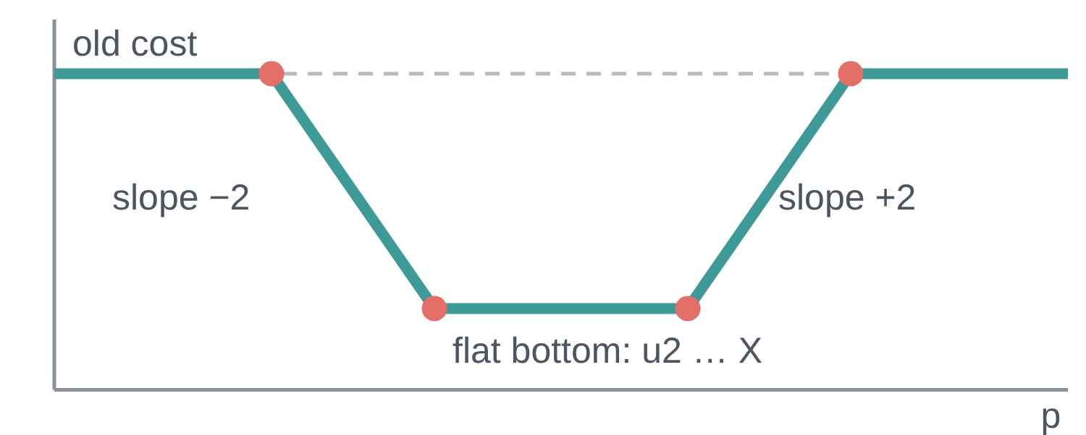
TWIN RIVERS · KEY OBSERVATION
EACH TRIP'S COST IS A SIMPLE SHAPE IN P
To Strip 2: a "V" capped flat by the old cost.
To Strip 3: a trough: flat bottom, slopes of ±2 on each side.
To Strip 2: V shape 1 + 2|X − p|, capped by old
w(p) = min(old, trough, …): slopes are only −2, 0, +2, with a few turning points.
To Strip 3: trough, flat from u2 to X, capped by old
● = corner (turning point)
Notes:
两种行程的代价函数都是折线：
去 Strip 2：V 形 1 + 2|X − p|，在 old 处被截平（新桥离 X 太远就不如旧桥）。
去 Strip 3：trough（槽形）：在 [u2, X]（或 [X, w2]）上是平底，离开平底每 1 km 增加 2，同样被 old 截平。平底高度是 2 + 2·(X − u2)。
红点是拐点（转折点）：斜率只在这些地方改变（−2、0、+2 之间切换）。每个行程最多只有几个拐点，这就是后面能用二阶差分的关键。
具体例子（样例 1，新桥建在 River 1）：行程 X = 4 去 Strip 3：u2 = 4，平底只有一个点，w = 6 6 4 2 4 6 6；行程 X = 3 去 Strip 3：只有右边的 w2 = 4，平底是 [3, 4]、高度 4，w = 6 6 4 4 6 6 6（p = 1..7）。

Slide 23
TWIN RIVERS · WHY A NEW TOOL?
WHY NOT JUST TRY EVERY P?
Brute force: for each of the ~10⁶ positions p, add up the cost of all 2×10⁵ trips.
Approach | Work per trip | Then | Total
Try every p | a value at every p: O(L) | — | O(T·L) ≈ 2×10¹¹ ✗
Second differences | only its few corners: O(1) | 2 prefix sums: O(L) | O(T log N + L) ≈ 5×10⁶ ✓
Each trip's cost w(p) is a broken line with only a few corners. Write down the corners only, then rebuild the total at every p in one pass.
To do that we need two ideas: the difference array, and the second difference.
Notes:
Brute force：L 约 10^6 个位置 p，每个 p 都要把 2×10^5 个行程的代价加起来，共约 2×10^11 次运算，远远超时（1 秒大约只能做 10^8 次）。
关键：每个行程的 w(p) 是一条折线，只有少数几个拐点（转折点）。我们只记下拐点处的信息（每个行程 O(1) 个位置），最后用两次 prefix sum 一次性还原出所有 p 上的总代价（O(L)）。再加上每个行程用 Binary Search 找最近的桥 O(log N)，总复杂度 O(T log N + L)，约 2×10^5 × 18 + 10^6 ≈ 5×10^6。
提问：能不能每个行程只算几个 p？答案：我们要的是"所有行程代价之和"在每个 p 上的值，最小值可能出现在任何 p，所以每个 p 的总和都要知道——但不需要一个 p 一个 p 地去加。
为了做到这一点，需要两个工具：差分数组（下一页）和二阶差分（再下一页）。

Slide 24
TWIN RIVERS · STEP 1: DIFFERENCE ARRAY
STORE THE JUMPS, NOT THE VALUES
Difference array: D[i] = a[i] − a[i−1] (with a[0] = 0). D is non-zero only where a jumps.
i | 1 | 2 | 3 | 4 | 5 | 6 | 7 | 8
a[i] | 3 | 3 | 3 | 7 | 7 | 7 | 2 | 2
D[i]
prefix sum of D
Prefix sum of D gives a back. Difference and prefix sum undo each other.
Classic use: "add v to a[l..r]" → D[l] += v, D[r+1] −= v. O(1) per update, one prefix sum at the end.
Notes:
差分（difference）就是相邻两项的差：D[i] = a[i] − a[i−1]。它记录的是"在哪里、跳了多少"。
答案：D = 3 0 0 4 0 0 −5 0；D 的前缀和 = 3 3 3 7 7 7 2 2 = a。差分和 prefix sum 互为逆运算。
经典用法（区间加）：把 a[2..4] 都加 5 → 只改 D[2] += 5、D[5] −= 5，最后做一次前缀和得到 3 8 8 12 7 7 2 2。每次修改 O(1)，最后还原 O(n)。
局限：差分数组只在"阶梯形"（分段常数，step function）的数据上省事。如果数据是斜线（每一格都在变），D 处处不为 0，就没有节省了——这就是下一页要讲二阶差分的原因。

Slide 25
TWIN RIVERS · STEP 2: SECOND DIFFERENCE
STORE THE BENDS, NOT THE VALUES
For a broken line, the first difference is the slope. The second difference is how much the slope changes: non-zero only at the corners.
p | 1 | 2 | 3 | 4 | 5 | 6 | 7
w(p) (trip X = 4) | 6 | 6 | 4 | 2 | 4 | 6 | 6
slope: w(p) − w(p−1) | —
d2: change of slope | — |  |  |  |  |  | —
d2[p] = slope(p+1) − slope(p) = w(p+1) − 2w(p) + w(p−1)
Rebuild: d2 → prefix sum → slopes → prefix sum → w(p). Start from w(0) and w(1).
Notes:
答案：斜率（一阶差分）w(p) − w(p−1)，p = 2..7：0, −2, −2, 2, 2, 0。
d2（斜率的变化），p = 2..6：−2, 0, 4, 0, −2。只有在拐点 p = 2、4、6 处不为 0。
为什么？折线在两个拐点之间是直线，斜率不变，所以斜率的差是 0；只有在拐点处斜率才改变。一阶差分（斜率）在斜线上处处不为 0，二阶差分只在拐点不为 0，所以每个行程只需要写 O(1) 个位置。
还原（两次 prefix sum）：已知 w(0) = 6、w(1) = 6，所以 slope(1) = 0。slope 依次加上 d2：0, −2, −2, 2, 2, 0；w 依次加上 slope：6, 4, 2, 4, 6, 6。和原来的 w 完全一样。
代码里的 tot[q+1] = 2·tot[q] − tot[q−1] + d2[q] 就是把这两次 prefix sum 合并成一行：tot[q+1] − tot[q] = (tot[q] − tot[q−1]) + d2[q]，即"新斜率 = 旧斜率 + 斜率变化"。

Slide 26
TWIN RIVERS · PUTTING IT TOGETHER
STORE CHANGES, REBUILD WITH PREFIX SUMS
Shape | Store | Rebuild with
Step function | d[q] = w(q) − w(q−1) | 1 prefix sum
Piecewise linear | d2[q] = w(q+1) − 2w(q) + w(q−1) | 2 prefix sums
Each trip adds its d2 only near its O(1) corners into one shared d2 array (sums of broken lines are broken lines). Then two prefix sums give the total cost at every p in O(L).
REBUILD FROM d2: TWO PREFIX SUMS IN ONE LINE
tot[q+1] = 2·tot[q] − tot[q−1] + d2[q]
⇔ tot[q+1] − tot[q] = (tot[q] − tot[q−1]) + d2[q] i.e. new slope = old slope + change of slope. Start from tot[0], tot[1].
O(T·L) → O(T log N + L)
Notes:
多个行程怎么办？二阶差分是线性的：总代价的 d2 = 每个行程的 d2 相加。所以所有行程都往同一个 d2 数组里写，最后只还原一次。
重点讲还原公式：tot[q+1] = 2·tot[q] − tot[q−1] + d2[q]。把它移项：tot[q+1] − tot[q] = (tot[q] − tot[q−1]) + d2[q]，左边是 q 到 q+1 的斜率，括号里是上一段的斜率，d2[q] 是斜率的变化。所以这一行其实就是两次 prefix sum：先累加 d2 得到斜率，再累加斜率得到 tot。需要两个起点 tot[0] 和 tot[1]（代码里的 v0、v1）。
用样例 1 的行程验证：w(0) = 6、w(1) = 6，d2[1..6] = 0, −2, 0, 4, 0, −2 → w(2) = 2·6 − 6 + 0 = 6，w(3) = 2·6 − 6 − 2 = 4，w(4) = 2·4 − 6 + 0 = 2，w(5) = 2·2 − 4 + 4 = 4，w(6) = 2·4 − 2 + 0 = 6，w(7) = 2·6 − 4 − 2 = 6。
复杂度从 O(T·L) 降到 O(T log N + L)。
提问：普通差分数组（一次 prefix sum）能还原什么样的函数？答案：只能还原分段常数函数（step function）。分段线性函数（折线）需要二阶差分 + 两次 prefix sum。

Slide 27
TWIN RIVERS · WORK IT BY HAND
TRIP X = 4 TO STRIP 3 (SAMPLE 1)
Bridges: River 1 at 2 and 6, River 2 at 4. Old cost = ___
p | 1 | 2 | 3 | 4 | 5 | 6 | 7
w(p)
d2[p] | — |  |  |  |  |  | —
Whole sample, new bridge on River 1 at p = 4: total = ___
Notes:
答案：原代价 Old cost：经桥 2 和 4 → 2 + 2·2 = 6（经桥 6 和 4 也是 6）。
w(p)，p = 1..7：6 6 4 2 4 6 6。
d2[p]，p = 2..6：−2, 0, 4, 0, −2（只有转折点 2、4、6 处不为 0）。
整个样例在 River 1 的 p = 4 建新桥：四个行程的代价是 4、2、4、3 → 总和 13。

Slide 28
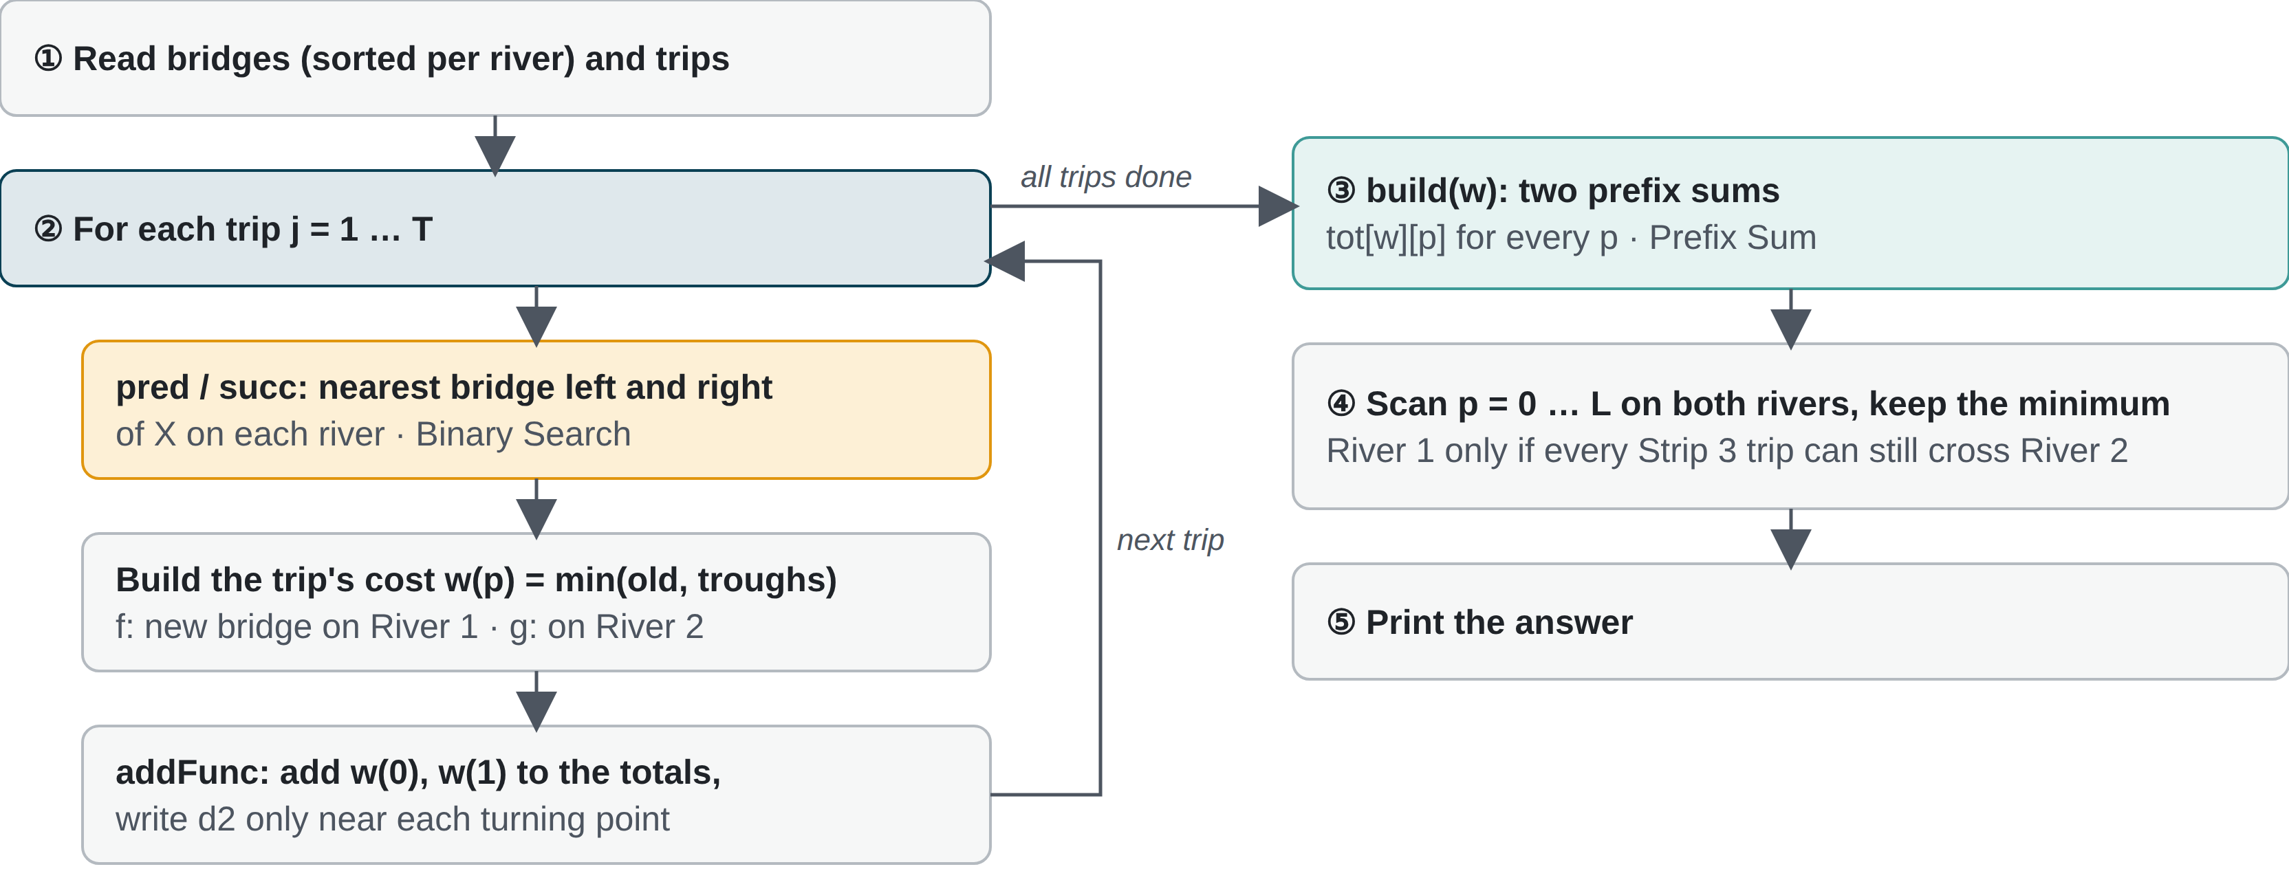
TWIN RIVERS · PROGRAM FLOW
THE BIG PICTURE BEFORE THE CODE
Notes:
先讲整体流程，再看代码。程序分 5 步：
① 读入，把桥按河分开存（每条河的桥排好序）。
② 对每个行程：用 Binary Search 找 X 左右最近的桥（pred / succ）；写出这个行程的新代价 w(p)，分两种情况：f 表示新桥建在 River 1，g 表示建在 River 2；再用 addFunc 把它加进总和——只在转折点附近写 d2，所以每个行程只写 O(1) 个位置。
③ build：两次 prefix sum，还原出每个 p 的总代价 tot[w][p]。
④ 扫一遍所有 p，两条河都看，取最小值。
⑤ 输出答案。
提问：循环里每个行程花多少时间？答案：两次二分 O(log N)，加上 O(1) 个转折点。总复杂度 O(T log N + L)。
提问：④ 里为什么有时不能把新桥建在 River 1？答案：如果有行程要去 Strip 3，而 River 2 上一座桥都没有，这些行程原本就完成不了，新桥必须建在 River 2（样例 3 就是这种情况）。

Slide 29
TWIN RIVERS · PSEUDOCODE
FIVE STEPS, THREE HELPERS
read bridges into br[1][], br[2][] (sorted), read trips
for each trip (X, S):
u1, w1 = pred(1, X), succ(1, X) // Binary Search: nearest bridges
u2, w2 = pred(2, X), succ(2, X)
old = best cost with the existing bridges
if S == 2:
f = min(old, 1 + 2|X − p|) // new bridge on River 1
g = old // new bridge on River 2: no help
else:
f = min(old, trough(u2..X), trough(X..w2))
g = min(old, trough(u1..X), trough(X..w1))
addFunc(1, f); addFunc(2, g) // d2 only near turning points
build(1); build(2) // two prefix sums → tot[w][p]
answer = min over p of tot[1][p] and tot[2][p]
Notes:
伪代码和完整程序 2024_P6_Twin_Rivers.cpp 一一对应：pred / succ 是两个二分函数；trough(a..b) 表示在 [a, b] 上是平底、两边斜率 ±2 的槽形函数，平底高度是 2 + 2·(b − a)；addFunc 只在转折点附近写 d2；build 做两次 prefix sum。
用样例 1 的行程（X = 4，去 Strip 3）验证：u2 = w2 = 4，所以 f 的两个 trough 都是 [4, 4]、高度 2；old = 6。f(p) = 6 6 4 2 4 6 6（p = 1..7），和手算页的结果一致。
去 Strip 2 的行程：新桥建在 River 2 对它没有帮助，所以 g = old（常数函数，d2 全是 0）。

Slide 30
TWIN RIVERS · CORE CODE
WRITE D2, THEN TWO PREFIX SUMS
// near each turning point q of one trip's function f
d2[w][q] += calc(f, q + 1) - 2 * calc(f, q) + calc(f, q - 1);
// rebuild the total cost at every p
for (int q = 1; q + 1 <= L; q ++)
tot[w][q+1] = 2 * tot[w][q] - tot[w][q-1] + d2[w][q];
w = 1: new bridge on River 1; w = 2: on River 2. Trap: if no River 2 bridge exists and some trip goes to Strip 3, the new bridge must go on River 2.
Notes:
转折点可能落在半整数上（两段函数相交处），所以代码在每个转折点附近多检查几个整数（用 2 倍坐标存）。完整程序：2024_P6_Twin_Rivers.cpp。复杂度 O(T log N + L)。

Slide 31
LIVE CODING · 20 MINUTES
WRITE SPACESHIP SHUFFLE FROM SCRATCH
Read N, A, B (arrays from index 1, long long)
p[i] = p[i-1] + a[i] - b[i]
Copy into q, sort, take q[(n+1)/2]
Add up |p[i] − med|
Test the samples: expect 5, 6, 3
Finished early? Print the "cut the chain" answer (f = 0) too and compare: sample 2 gives 10 vs 6.
Submit: orac2.info/problem/1198
Notes:
下去巡视。最常见的 bug：用 int 而不是 long long；q 没有从下标 1 开始排序；把 p 原地排序后又拿来用（应该排序一份拷贝）。
样例答案：样例 1 = 5，样例 2 = 6，样例 3 = 3。

Slide 32
RECAP
THREE FACES OF PREFIX SUM
Problem | How Prefix Sum is used | Also uses
Spaceship Shuffle | Prefix sum = flow on each edge | Greedy: the median
Tennis Robot II | Lowest prefix value + net change per round | Division: rounds each bin survives
Twin Rivers | Second differences + two prefix sums | Binary Search: nearest bridge
See "running total", "per round" or "range"? Think Prefix Sum first.
Notes:
让每个学生说出今天的一道题，以及它用了哪个技巧。
参考答案：Spaceship Shuffle：Prefix Sum（每条边的流量）+ Greedy（中位数）；Tennis Robot II：Prefix Sum（一轮的最低点和净变化）+ 除法算轮数；Twin Rivers：二阶差分 + 两次 Prefix Sum，再用 Binary Search 找最近的桥。

Slide 33
BEFORE LESSON 2
HOMEWORK
Tennis Robot II: full program (one round of prefix sums + division + simulate one round) · orac2.info/problem/1466
Twin Rivers subtasks 1–2: brute force over p first, then second differences · orac2.info/problem/1462
Think: if each edge in Spaceship has its own price per person, does the median still work?
Notes:
下次课：Binary Search 和 Two Pointers。提醒学生把课程笔记里的 binary search 模板带来。

